Slide 1
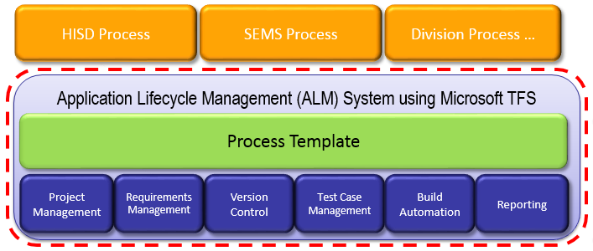
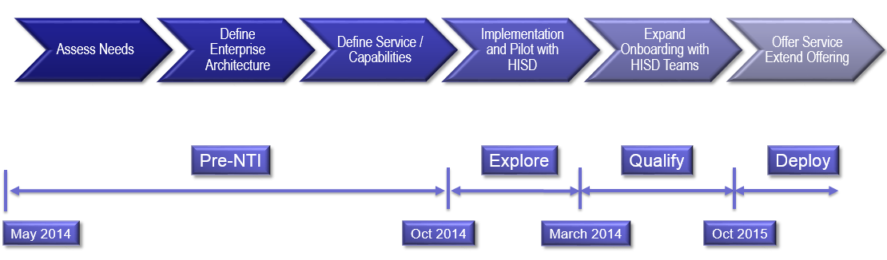
Enterprise Team Foundation Server (NTI)
Businesses – HIS, IPD, TSSD/MVSS, PSD, Unitek
Technology:
Establish an Application Lifecycle Management (ALM) Support System by leveraging Microsoft Team Foundation Server (TFS).
Objective:
Implement an Enterprise Team Foundation Server providing
Develop team of ALM specialists to support 3M software businesses
Status:
Pre-NTI
Progress:
Multiple Divisions engaged – HIS, IPD, TSSD, PSD
Cost of Service Complete
HIS Team onboarding (ongoing)
Engage with Microsoft MCS team
220 Users as of Feb 1
January - first usage Division Chargeback
Define System Governance
Construct Enterprise Build Services
Construct Enterprise Test Services
Define & Implement external access
Timeline
Project Management | Test Case Management
Requirements Management | Build Automation
Version Control | Reporting
Key SEMS Contacts: Mike O’Brien

